Slide 1
10 Ways to Make Your Plan a Litigation Target
401(k) Plan Fiduciary Governance
Notes:
Hi, I’m Clint Crocker and welcome to our Fiduciary Governance webinar series. Today, I'm briefly going to highlight the importance of Fiduciary Governance along with an overview of our fiduciary governance training series.
I've had the opportunity to work with retirement plans and retirement plan committee members for over 30 years. The role of a committee member is important yet I rarely see someone who “signed up” to be a professional fiduciary and committee member. Most times, a person becomes a fiduciary based on their background and role in the company.
Key item – a fiduciary is a person that makes discretionary decisions on a retirement plan. This role is done by a company’s leadership or committee. Here's the challenge for a committee member - as a committee member you are a fiduciary and you find yourselves in a role with personal liability for your actions - and actions of your co fiduciaries, with an expectation of prudence that courts have described as the highest known to law. Our experience is that most committee members, prior to working with our firm, have had little to no training on how to be a good fiduciary.
In our fiduciary governance series, we will give you education and tools to help you be a professional fiduciary. Before we begin, let me give you an example of a recent court case where fiduciary governance training made all the difference.
Plaintiff law firms have made millions of dollars suing mutual fund companies that have their own 401(k) and only use their own funds. Many of the largest mutual fund companies have settled before their case went to trial. A recent case, went to trial for 11 days and the judge dismissed all of the claims by the plaintiff attorney.
A key part of the judge's decision was that the fiduciaries / committee members took their fiduciary duties seriously and participated in fiduciary training and ongoing committee meetings and then documented the results.
Our goal is to help give you some building blocks so that you can be stewards of the retirement plan you offer your employees. Good stewards are great fiduciaries. Now, let us begin.

Slide 2
Preface & Disclosure
This information has been taken from sources, which we believe to be reliable, but there is no guarantee as to its accuracy. It is not a replacement for any account statement or transaction confirmation issued by the provider. This material is not intended to present an opinion on legal or tax matters. Please consult with your attorney or tax advisor, as applicable.
The tax and legal references attached herein are designed to provide accurate and authoritative information with regard to the subject matter covered and are provided with the understanding that Barry, Evans, Josephs & Snipes is not engaged in rendering tax or legal services. If tax or legal advice is required, you should consult your accountant or attorney. Barry, Evans, Josephs & Snipes does not replace those advisors.
Investments in securities involve risks, including the possible loss of principal. When redeemed, shares may be worth more or less than their original value.
Investors should consider the investment objectives, risks, charges and expenses of any product carefully before investing. This and other important information about the investment company is contained in each product's prospectus, which can be obtained by calling (704) 333-0508. Please read it carefully before investing.
Dollar cost averaging involves a continuous investment in securities regardless of fluctuating prices levels. It does not ensure profit or protect against loss. The investor should consider his/her ability to continue purchases through periods of low-price levels.
Diversification does not ensure a profit or protect against loss in a declining market.
Securities offered through M Holdings Securities, Inc. A registered Broker/Dealer, Member FINRA/SIPC. Barry, Evans, Josephs & Snipes is independently owned and operated.
2802967.1

Slide 3
Company Leaders are Busy
Employee Retirement Income Security Act (ERISA)
Highest Standard of Law
Personal Liability Statute
Mandates Fiduciaries…
Protect retirement benefits
Ensure reasonable fees with benchmarking and RFPs
Manage legal / financial risks
Avoid conflicts of interest
Document processes and decisions
Notes:
In our work with our clients, we know that many times, the busiest and the brightest employees are on the 401(k) committee. All of you are very busy, whether you're the owner, CEO, CFO, or a leader in Human Resources. I would anticipate that this question may come to your mind, "I'm already working 50 to 60 hours a week; I'm too busy to watch these webinars."
Here's the reason why all of our clients have appreciated Fiduciary Governance training - the government realized you wear two hats as you support your retirement plan. You are a leader of a company, and you also represent the employee’s interests in retirement plan.
It's our experience that many of our new clients come to us without the realization that they had professional fiduciary duties. They were “accidental fiduciaries.”

Slide 4
4 Goals We Typically See for Companies Like Yours
Goal 1:
Reduce Work
Goal 2:
Reduce Risk
Goal 4:
Save Money
Goal 3:
Greater Expertise

Slide 5
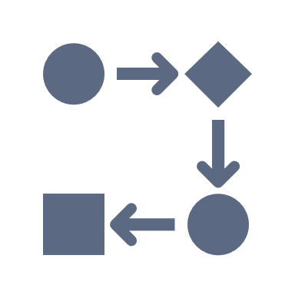
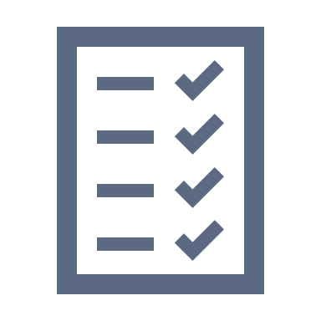
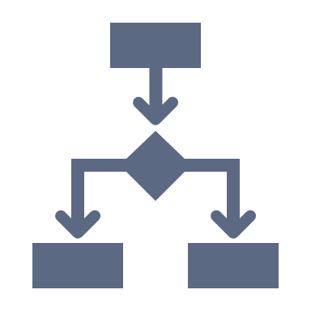

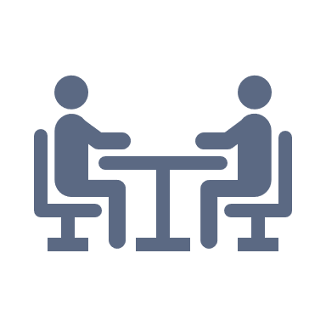
10 Ways to Make Your Plan a Litigation Target
Not Having a PROCESS
Example: Investment Policy Statement (IPS)
Failing to DOCUMENT the Process
Example: Minutes, Vault
Not Understanding and Reviewing Your OPTIONS
Example: Investment Share Classes
Choosing Not to ENGAGE OUTSIDE EXPERTS
Example: Fiduciary Consultant
Fixing Issues Without CONSULTING OUTSIDE COUNSEL
Example: Untimely Contributions

Slide 6



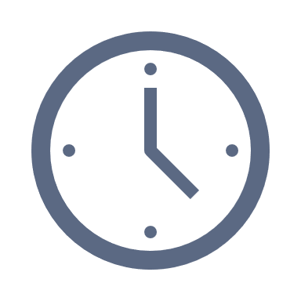


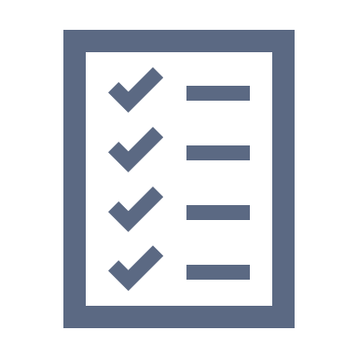

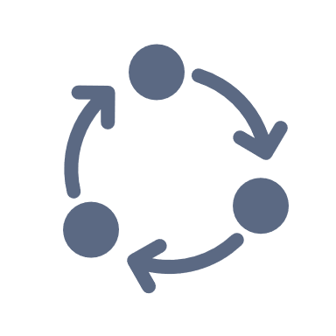
10 Ways to Make Your Plan a Litigation Target
Never ANALYZING Your Target Date Funds / QDIA
Example: Glidepath, Proprietary Revenue
Failing to MONITOR & BENCHMARK Fees
Example: Recordkeeper, TPA, Advisor, Investments
Being Too Busy to MEET REGULARLY
Example: Committee Meetings
Selecting and Not REVIEWING Service Providers
Example: Service Agreements
Believing a REGULAR RFP PROCESS is Unnecessary
Example: Market Pricing

Slide 7
RECENT Court Cases & Best Practices
In Practice
Notes:
Let's begin with defining who the fiduciaries are on your plan. Many times I find that companies think their record keeper is the administrator and fiduciary on the plan. A fiduciary is actually someone who makes discretionary decisions on the retirement plan.
Fiduciary status is based on the functions you perform for the plan, not your title. Some of our clients have the business owners as the committee while others have a formal committee that meets.
As you look at your company or organization, the fiduciaries are the people that have discretion and are making decisions on the plan. Keep in mind that hiring someone to perform a fiduciary function is in itself a fiduciary act.

Slide 8

Think Your Plan is Too Small to be Sued?

Slide 9











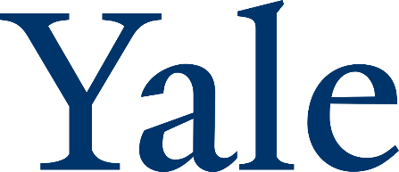
Common Theme?

Slide 10
NYU Lawsuit
NYU, MIT, and Yale sued by Plaintiff attorney, Jerry Schlichter
Plaintiff law firm has a history of winning
  $334 Million in settlements ($90 Million for the firm)
  WSJ article – Lawyer on a Quest to Lower Fees
Plaintiff attorney sued 11 large universities – most settled
  NYU was first court case
Complaint on: Excessive Fees, Investment Offering, and Investment Monitoring
  Plaintiff alleged plan loss of $358 Million
NYU has two plans with $4.2 Billion
NYU had a 9-person committee – broad representation (finance, HR)
  Hired investment advisor as a 3(21) fiduciary in 2009
Notes:
NYU, MIT, and Yale were sued by Plaintiff attorney Jerry Schlichter
Plaintiff law firm has a history of winning - $334mm in settlements / $90mm for the firm
WSJ article Lawyer on a Quest to Lower Fees
Plaintiff attorney sued 11 large universities – most settled. NYU was first court case.
Complaint on: Excessive fees (failure to monitor, use of RFP), investment offering (too many funds – over 100), and investment monitoring (failure to remove poor performing funds – TIAA Real Estate, TIAA Stock). Plaintiff alleged plan loss of $358mm
NYU has two plans with $4.2 billion
NYU had 9 person committee – broad representation (finance, HR)
Hired investment advisor as a 3(21) fiduciary in 2009

Slide 11

No Plan is Immune

Slide 12


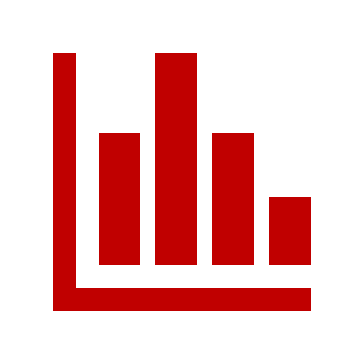


Litigation Update – American Century
Background
Plan Size: $745 Million
Active Participants: 1,300
Broad Investment Committee
Complaint was filed by a FORMER EMPLOYEE
Litigation Surrounding
Investment
Selection
Investment
Monitoring
Fees
Notes:
Jerry Schlitchter is an attorney who started the majority of 401k/403b lawsuits (he was a former Slip and Fall attorney).
Jerry’s firm has made roughly $90 million from these lawsuits since 2010.
His firm filed 31 cases last yea alone.
Needless to say, Jerry and his firm have won a lot of cases.

Slide 13
EXAMPLES of Key Deliverables
You Should Have
In Practice
Notes:
Let's begin with defining who the fiduciaries are on your plan. Many times I find that companies think their record keeper is the administrator and fiduciary on the plan. A fiduciary is actually someone who makes discretionary decisions on the retirement plan.
Fiduciary status is based on the functions you perform for the plan, not your title. Some of our clients have the business owners as the committee while others have a formal committee that meets.
As you look at your company or organization, the fiduciaries are the people that have discretion and are making decisions on the plan. Keep in mind that hiring someone to perform a fiduciary function is in itself a fiduciary act.

Slide 14
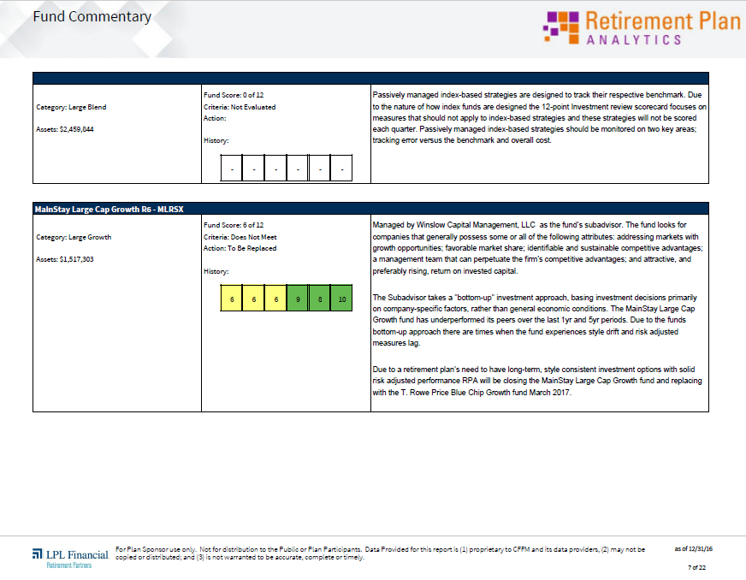

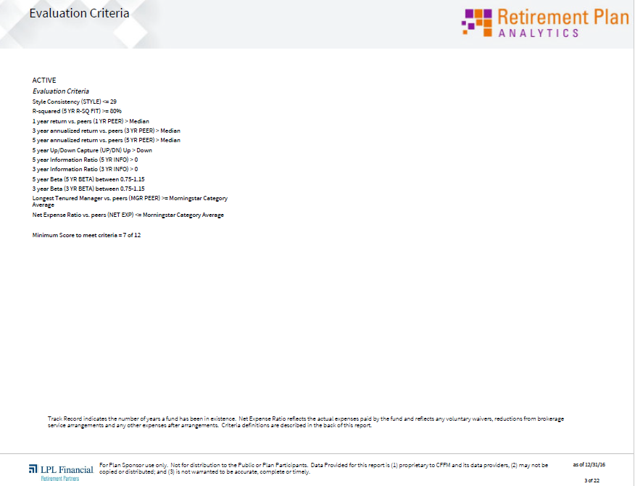
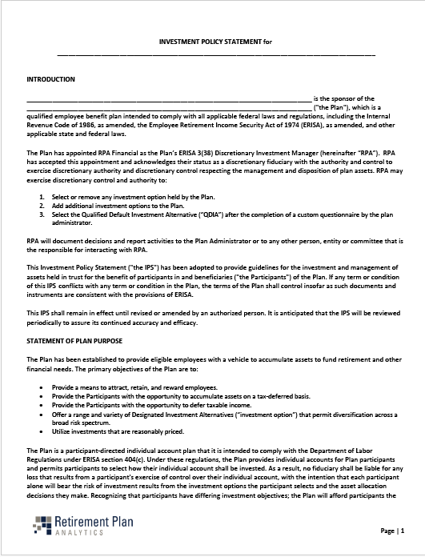
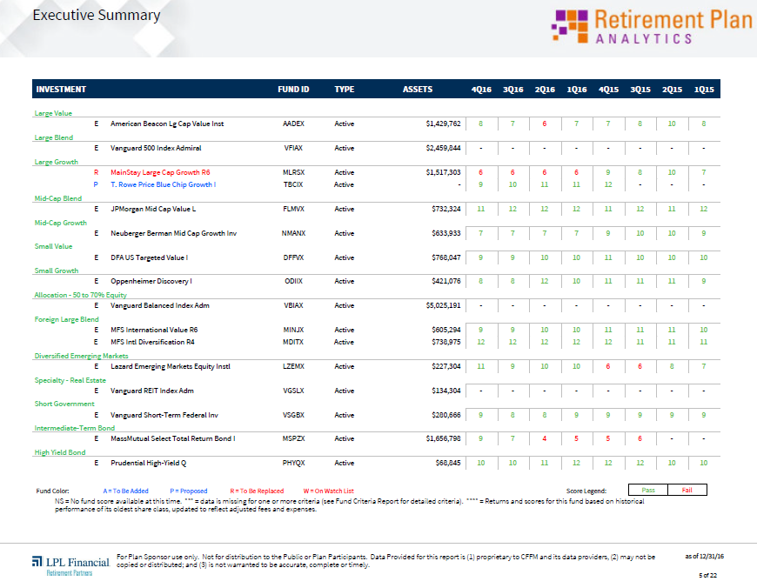
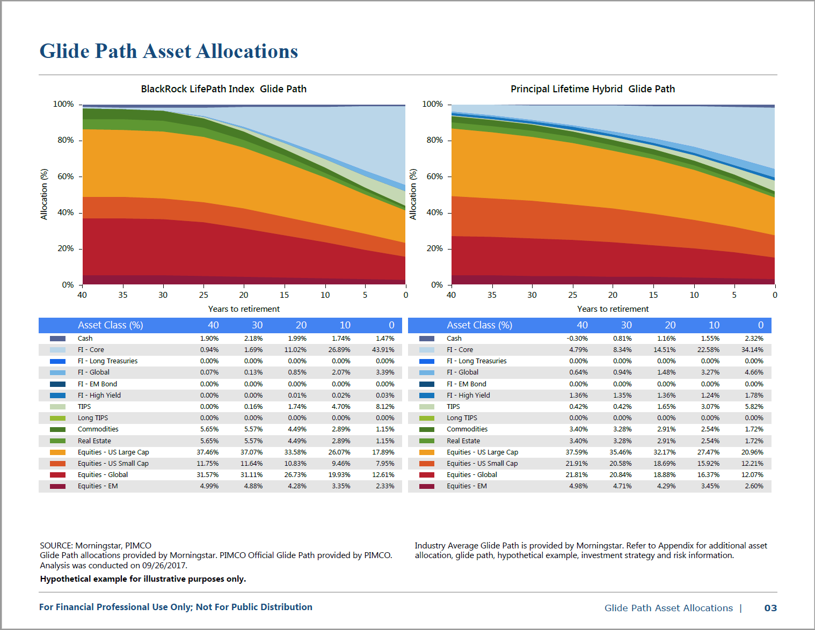
Investment Process
SAMPLE
SAMPLE
Asset Class Selection
Glide Path
Implementation
Return & Risk
Holdings Analysis
Operations
SAMPLE
Notes:
The IPS is the framework around the investment decisions and process
The IPS outlines the criteria being evaluated for the investments
The IPS ties directly into the quarterly investment scorecard which outlines the investment criteria evaluated and is uploaded to your vault and reviewed each year in your plan review

Slide 15
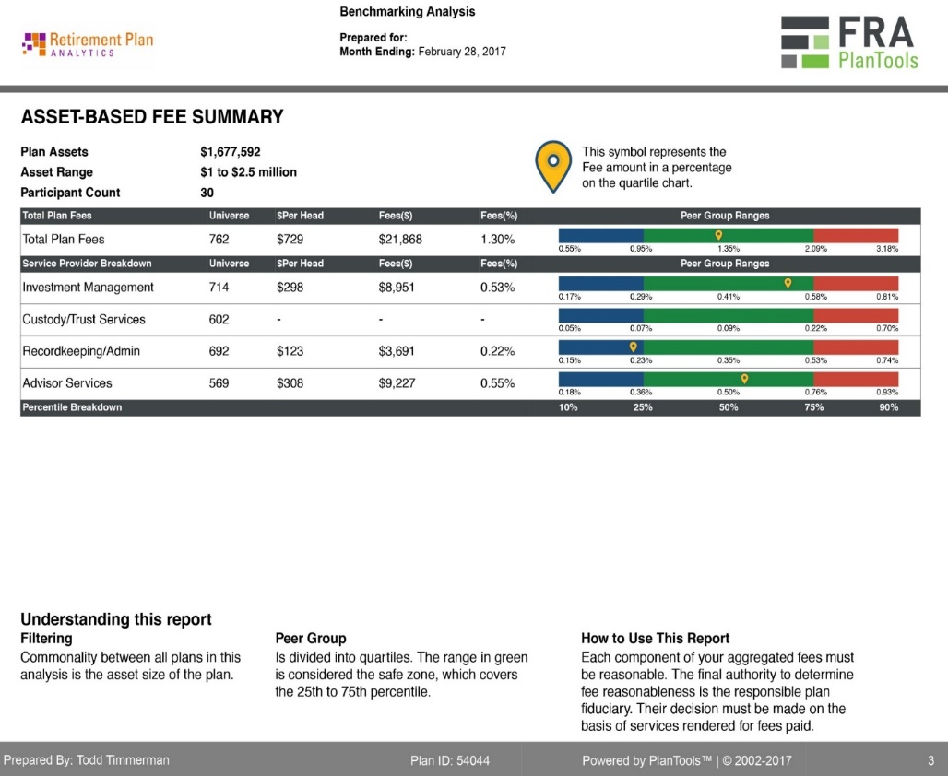
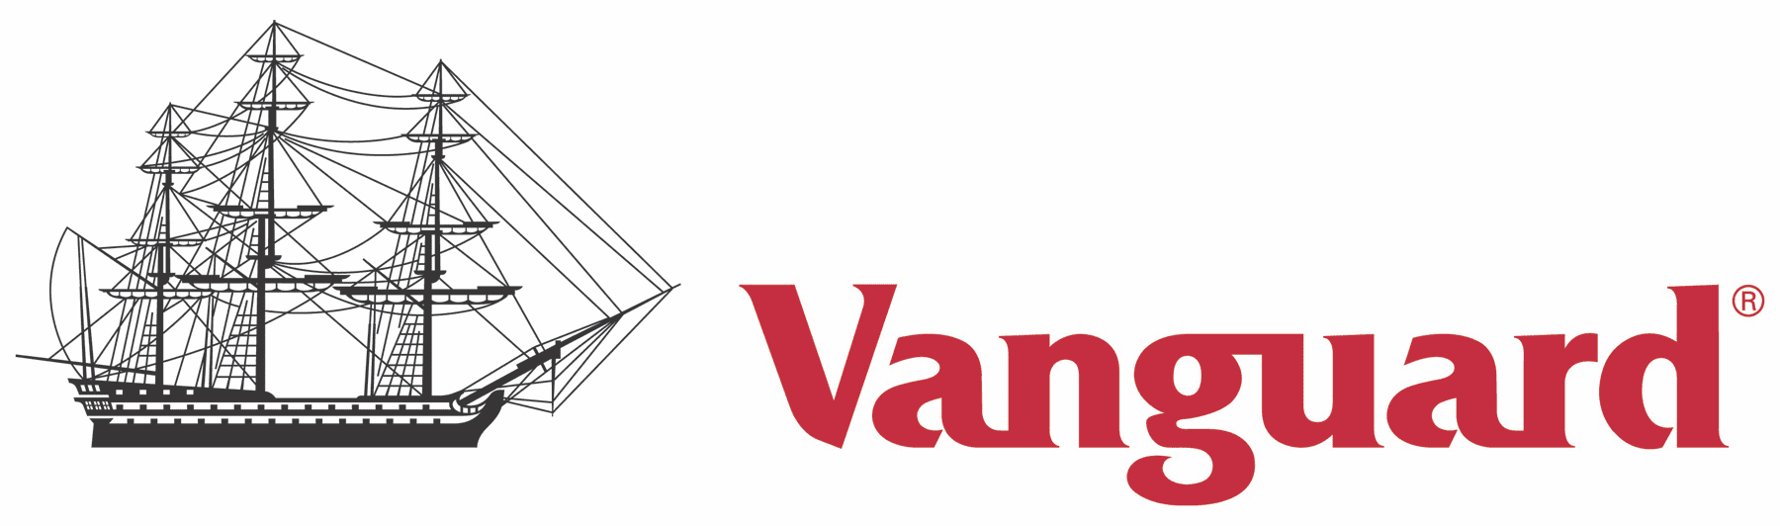
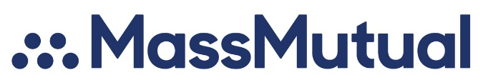
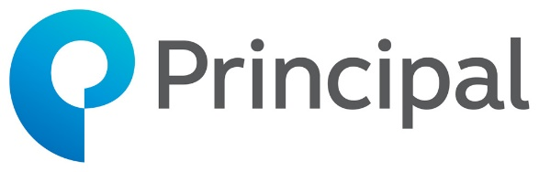

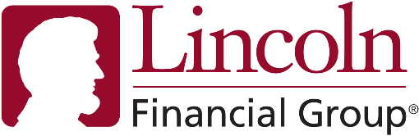


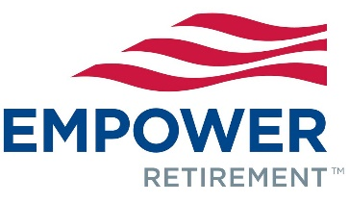
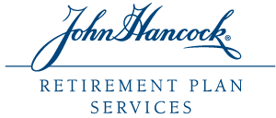
Expense Reasonableness

Slide 16
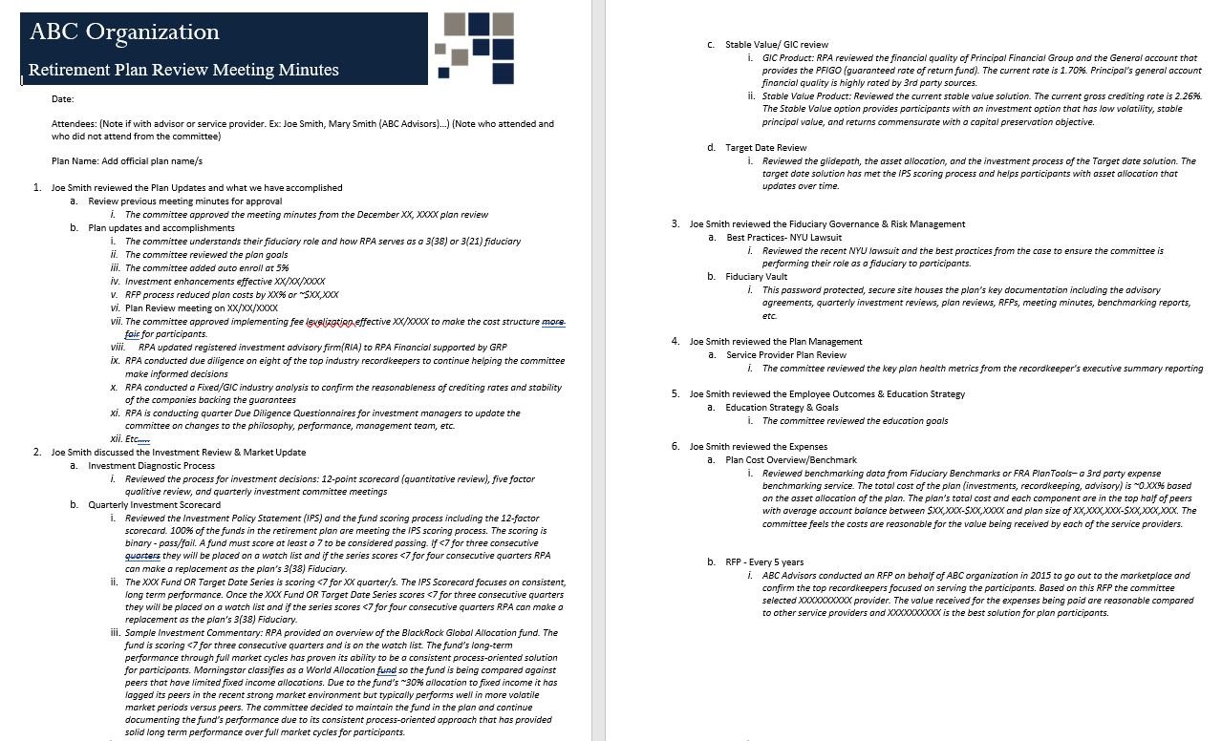
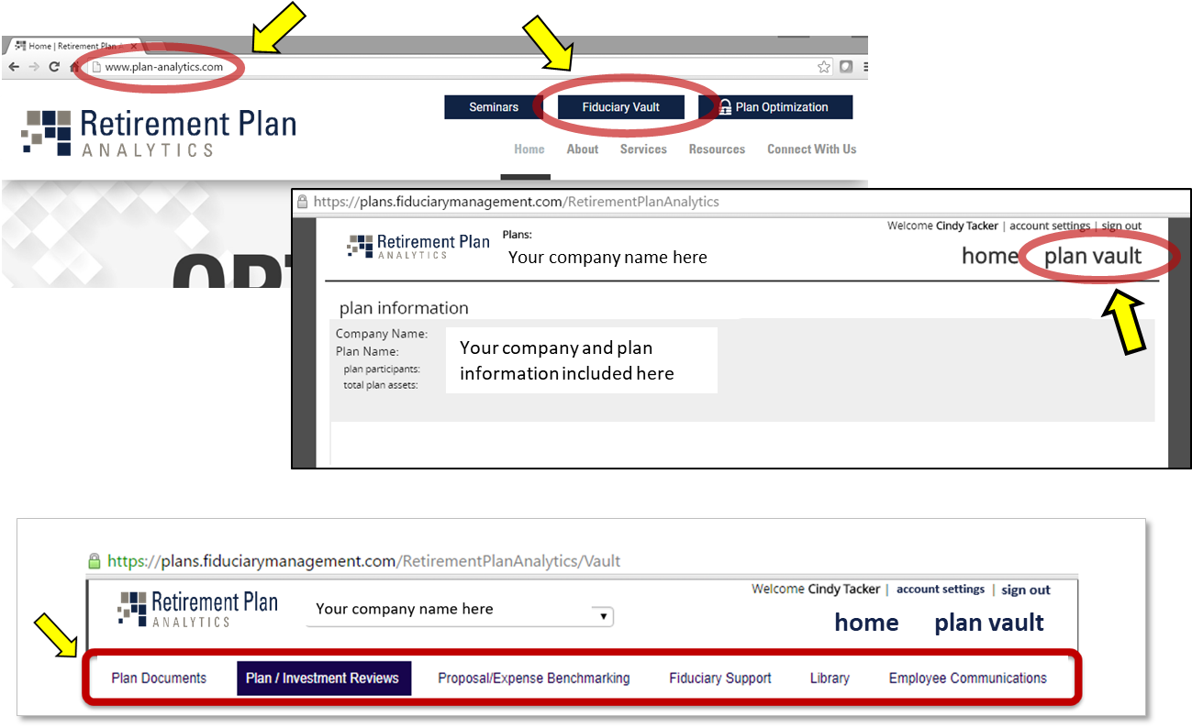
Documentation of Processes
Meeting Minutes
Fiduciary Vault
Notes:
As we discussed in the recent litigation overview, documentation of processes continues to be key. We wanted to do a quick review of the fiduciary vault that we provide for all our clients. It’s a great place to house your documentation.
You can access the vault by going to our website at plan-analytics.com. You’ll see in the upper righthand corner a link to login to your secure, fiduciary vault.
Once you’ve logged in you see several different tabs at the top of your screen – Plan Documents, Plan and Investment Reviews, Request for Proposal/Expense Benchmarking, Fiduciary Support and Employee Communications.
Within each tab there are several folders created to help organize the various documents. You have the ability to save, download or print any documents as needed. You also have the ability to add and upload documents

